Slide 1
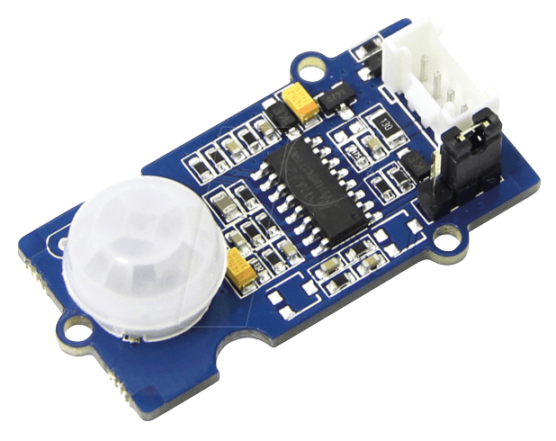
Lumi Monitor – PIR Motion Sensor
Kyle Voduris

Slide 2
Proposal
PIR Motion Sensor = Passive Infrared Motion Sensor
The Lumi Monitor tracks data on feeding time, sleep time, temperature, etc.
The Motion Sensor will initiate the collection of data when the parent is standing in front of it for a shot period of time.
This will keep the Lumi Monitor hands free to help busy parents who have their hands full.

Slide 3
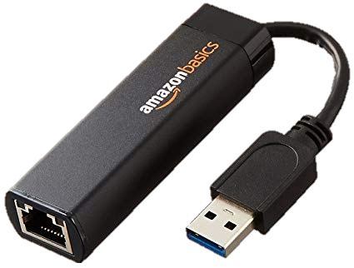
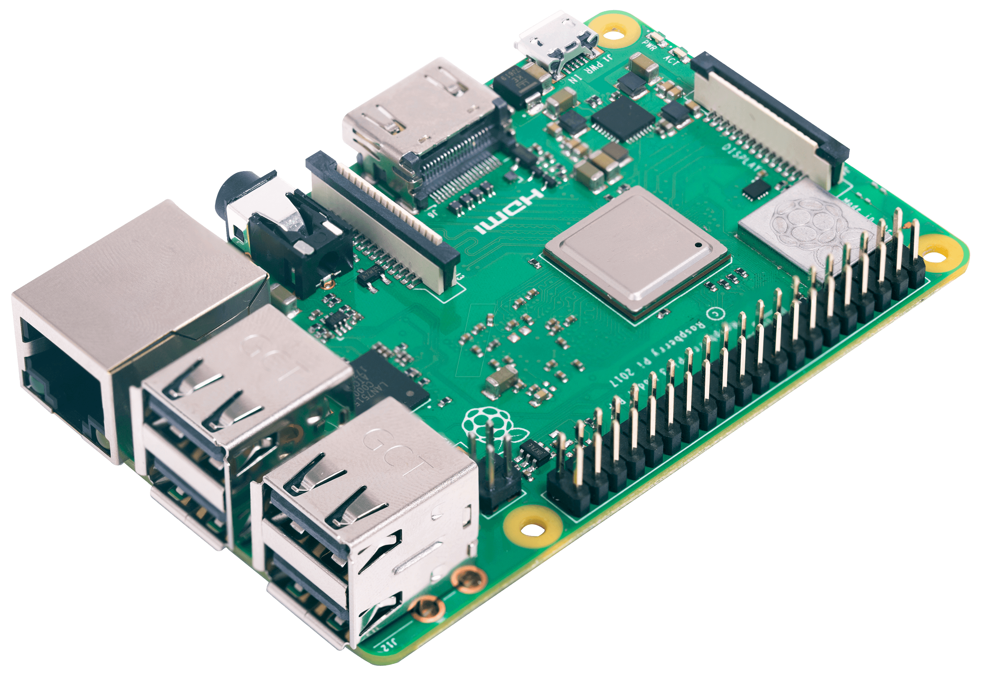
Budget
Part | Price
Raspberry Pi 3B+ | $63.25
Grove PIR Motion Sensor | $19.91
Seedstudio Grove 4-pin Connectors | $11.67
AmazonBasics USB 3.0 To Ethernet Adapter | $24.58
32GB MicroSD Card | $0.00
USB Power Adapter | $0.00
Ethernet Cable | $0.00
Electronics Parts Kit | $0.00
Total: $119.41
Notes:
Raspberry Pi 3B+
Grove PIR Motion Sensor
Seedstudio Grove 4-pin Connectors
AmazonBasics USB 3.0 To Ethernet Adapter

Slide 4
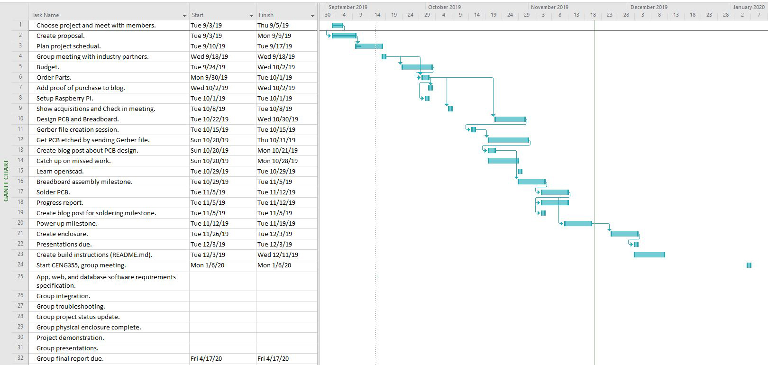
Schedule
The schedule I tried to follow to so that my project would finish on time.
I went off schedule a twice but worked to put the project back on track each time.
Completed my project on time.

Slide 5

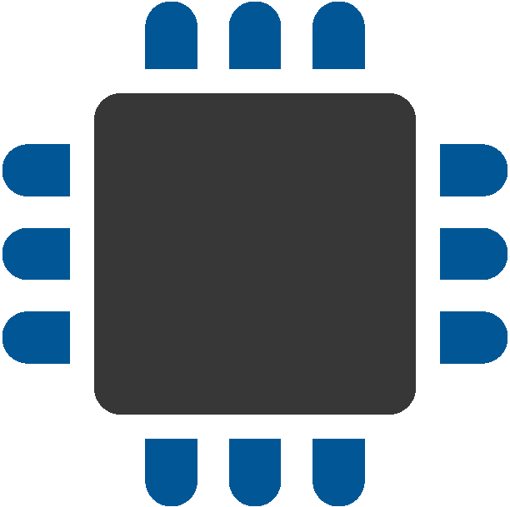
Course Knowledge
TECH 101 – Electric Circuits
Fundamental electronics and circuits knowledge.
TECH 153 – Technical C
Introduce the use of Raspberry PI.
Fundamental programming knowledge.
CENG 200 – Unix Scripting
Learning a Unix based command line interface.
CENG 216 – Software Engineering
Learn to complete projects efficiently.
Gantt Charts.
CENG 252 – Embedded Systems
Programming sensors on a Raspberry Pi.

Slide 6
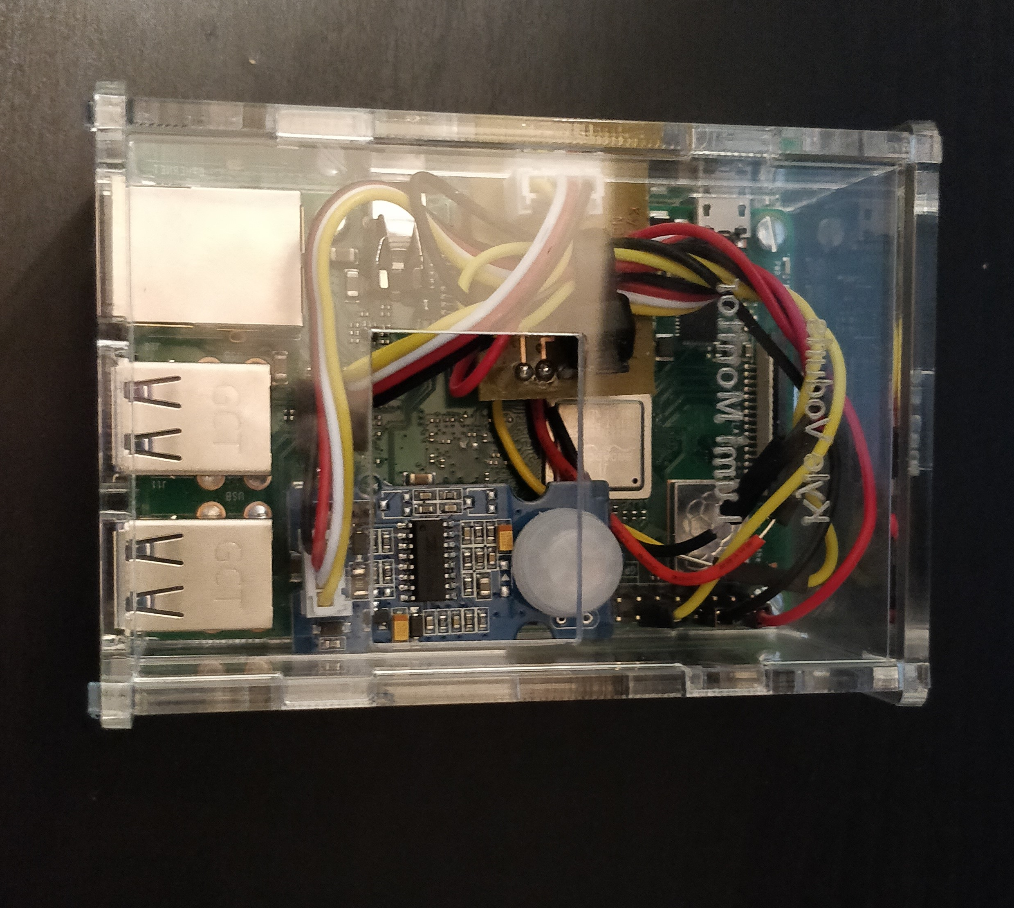
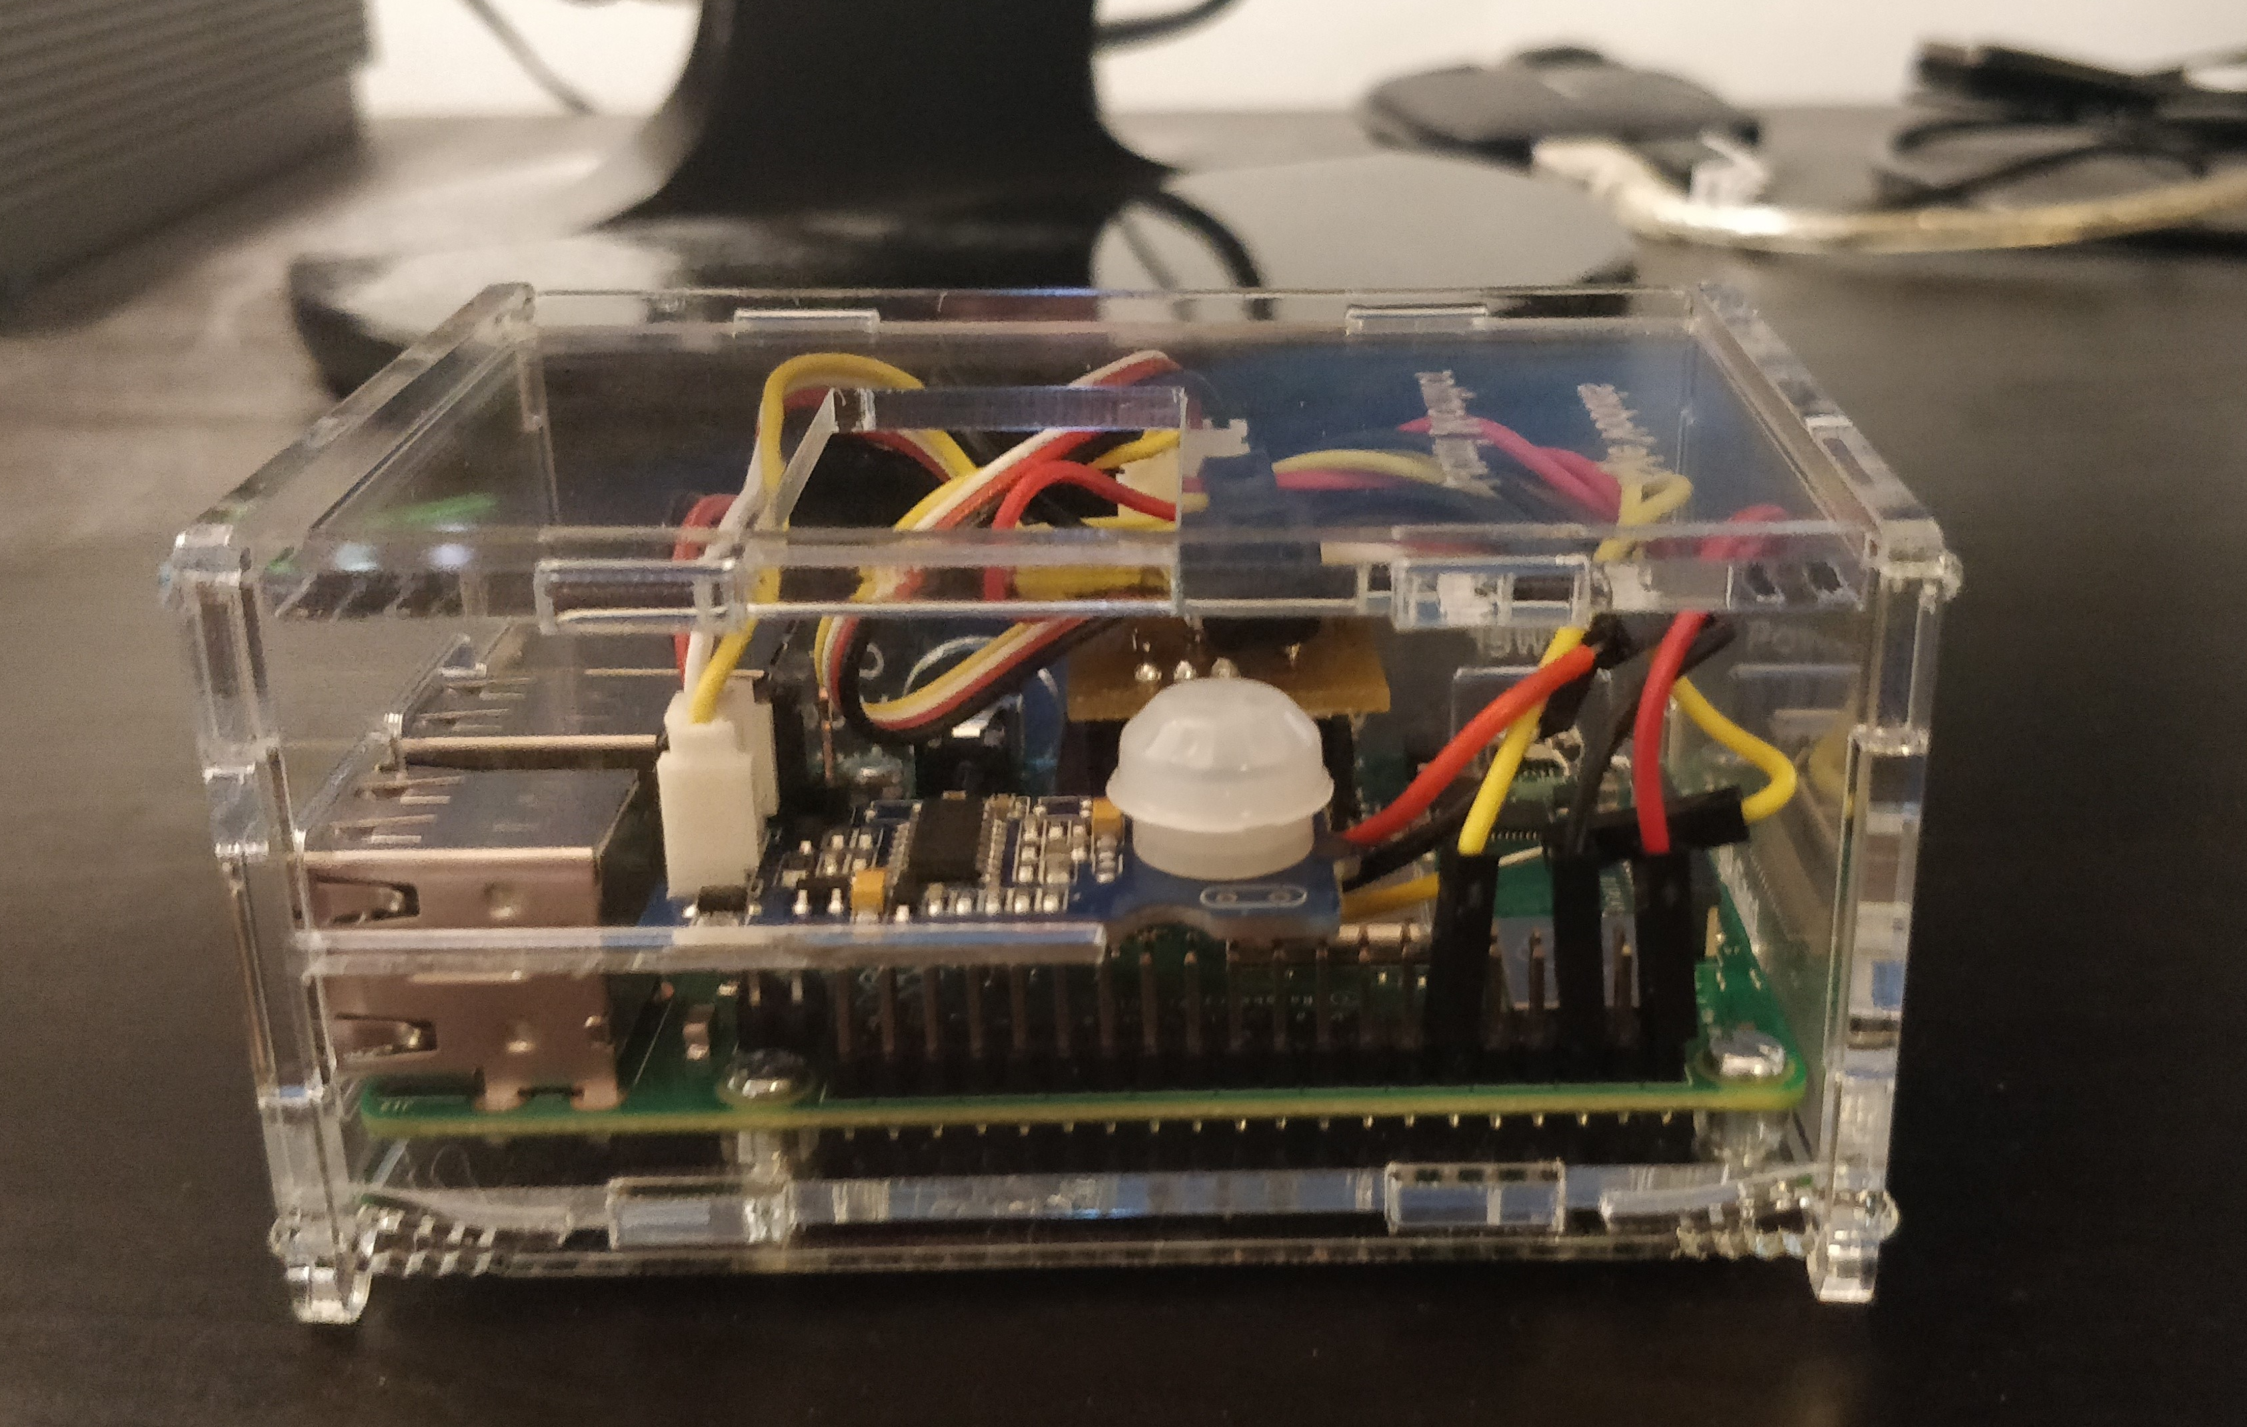
Enclosure
Top View
Side View

Slide 7
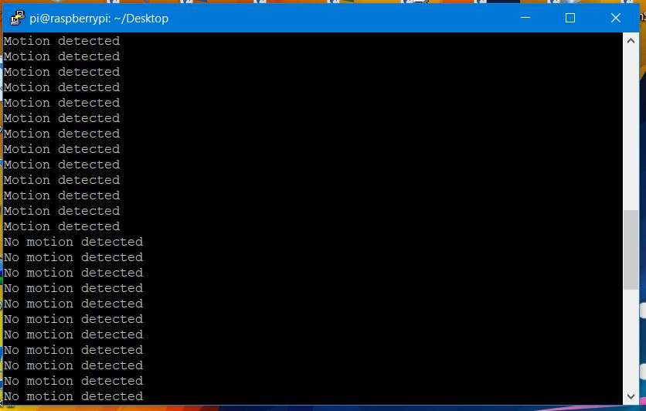
Detecting Motion

Slide 8
Thanks For Watching

